Slide 1


Slide 2
Number 1 business software in South East Asia use by more than 180,000 companies.
We empower more than 600,000 accounting and business professionals using
SQL Account and SQL Payroll to perform their daily operation effectively.

Slide 3
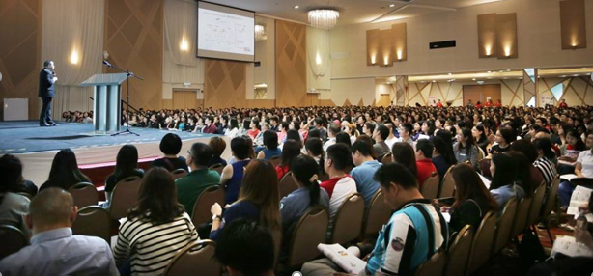
More than 400 service centers in Malaysia is ready to help your business grow.
To support local business communities, SQL run monthly free trainings and sponsor accounting and tax seminars across all cities in Malaysia.

Slide 4

SQL - PUBLIC LISTED co & PROMINENT USERS
MORE THAN 180,000 ACCOUNTING & BUSINESS USE sql account & sql payroll for their daily operation.

Slide 5




































Slide 6
































Slide 7




































Slide 8

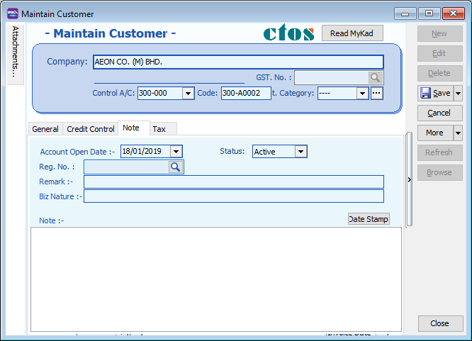
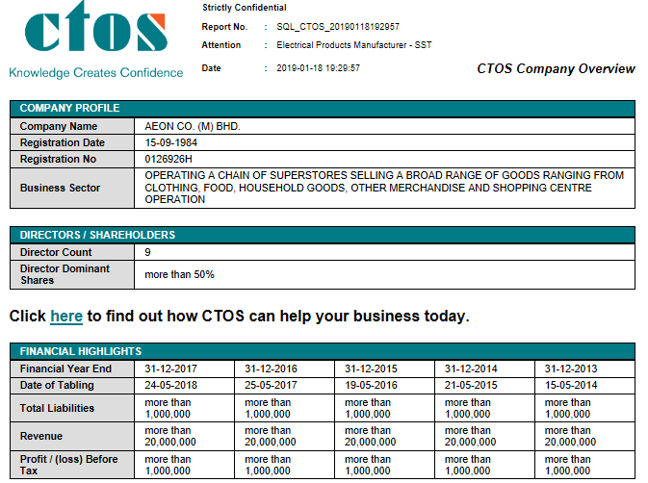
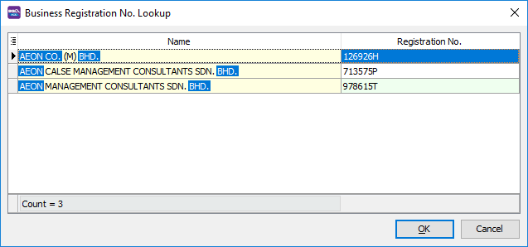

Slide 9



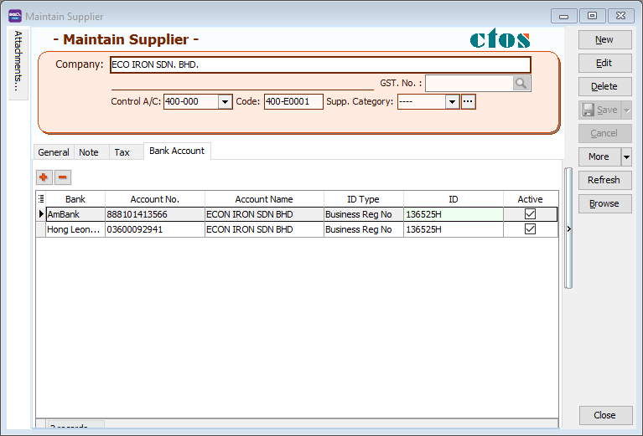

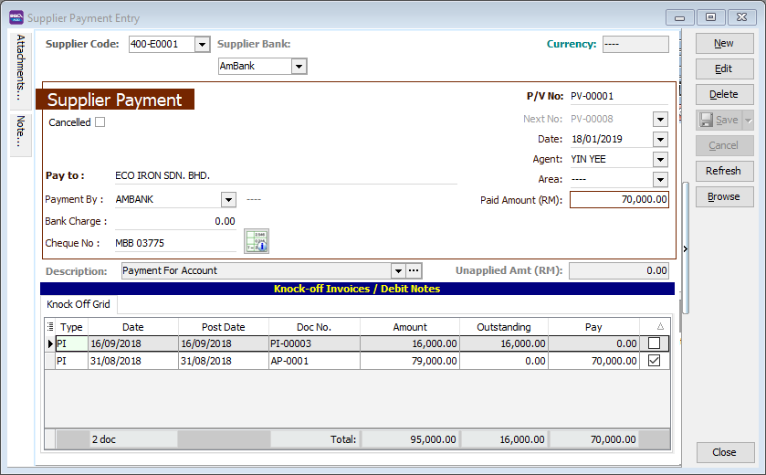



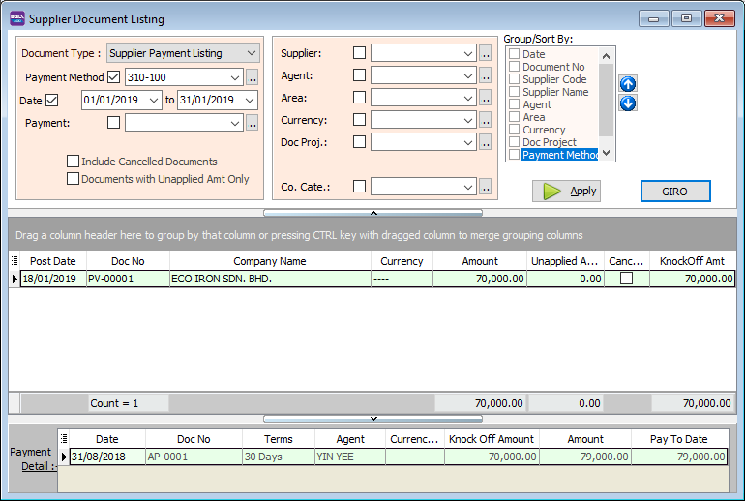




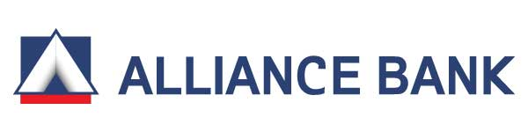





Giro to ALL Banks
Bank Giro

Slide 10
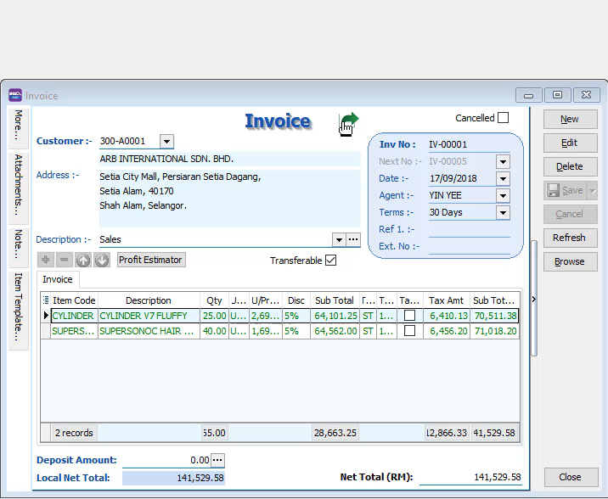
WhatsApp Feature

Slide 11
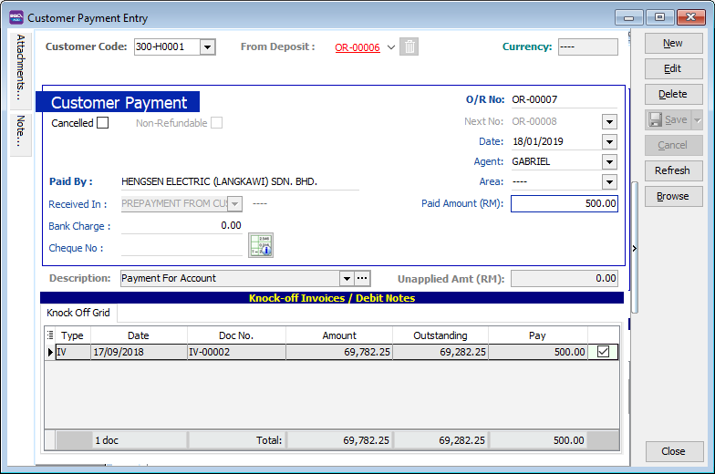
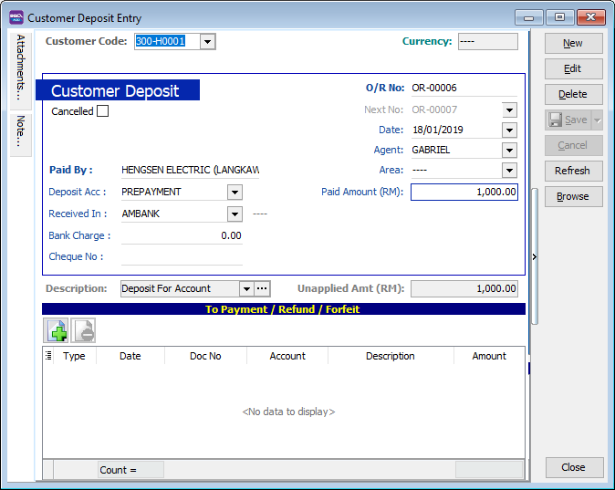
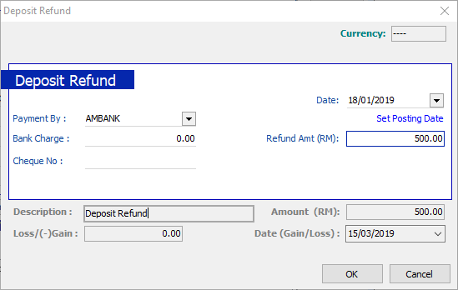
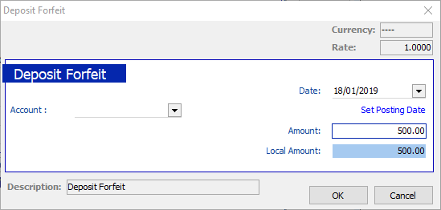
Security Deposit
Refund the security deposit later?
Security deposit received from customer
it can be also use to offset
any of your outstanding invoice !!
or forfeit it?

Slide 12
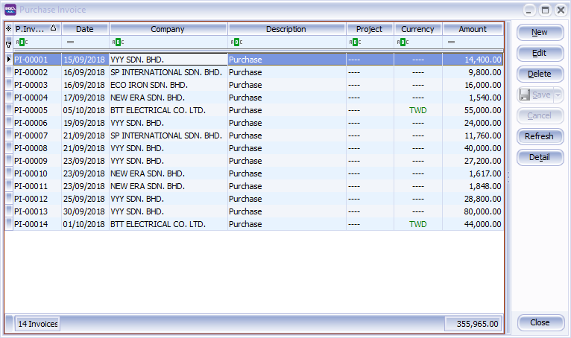
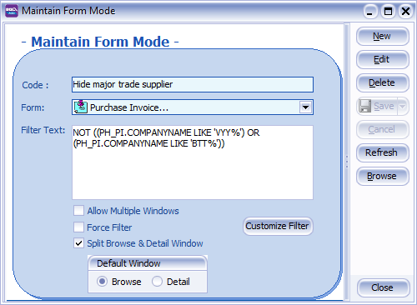
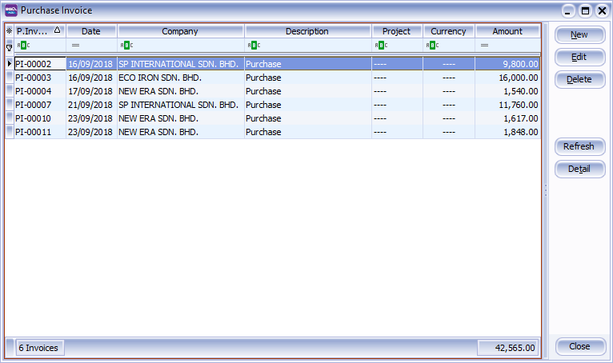

Advance Security Form Mode
This is so useful to lock users on certain keywords within the modules.
All invoices (in staff view)
in boss view : hided trade suppliers
Hide VYY & BTT trade supplier
users allow to view purchase invoice,
but not allow to see major trade supplier invoices?

Slide 13
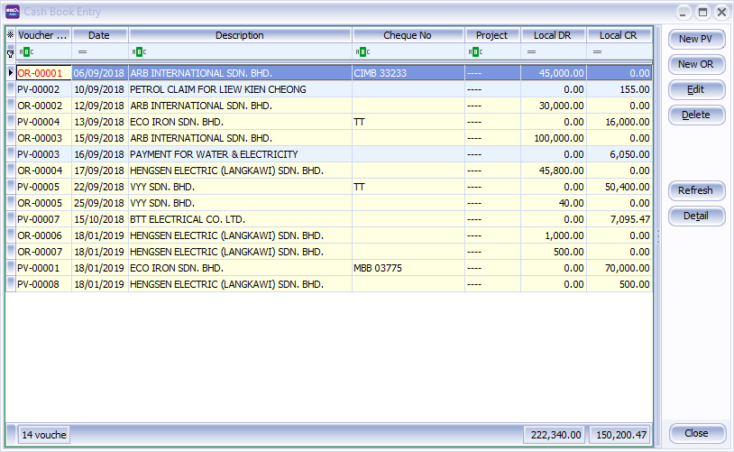
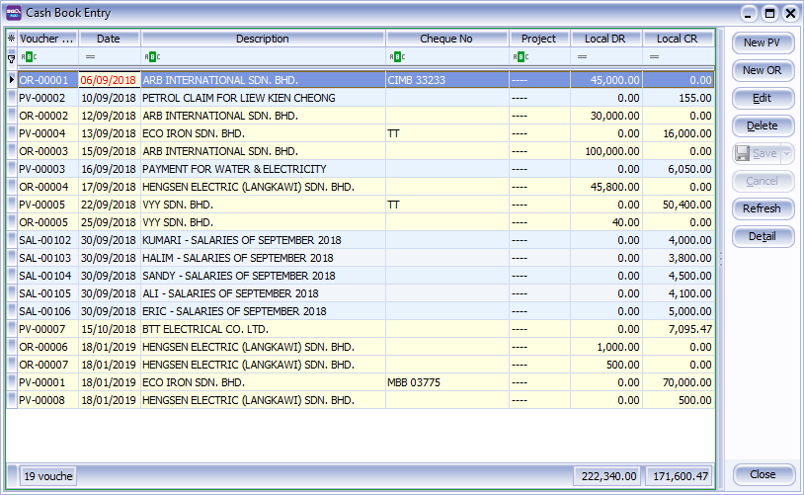
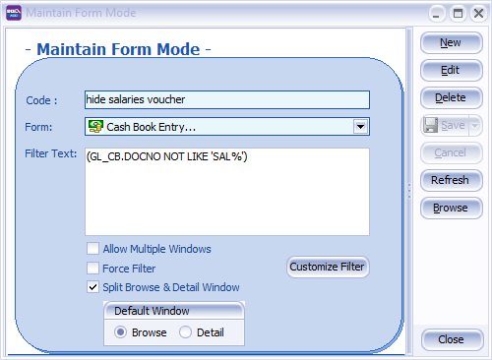
Advance Security Form Mode
Setting to hide salaries voucher
Staff can access cash book entry,
but cant see salaries info
All Payment Voucher included salaries

Slide 14
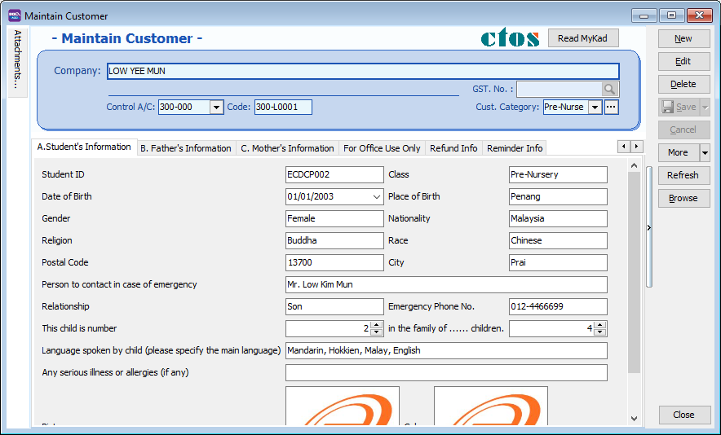
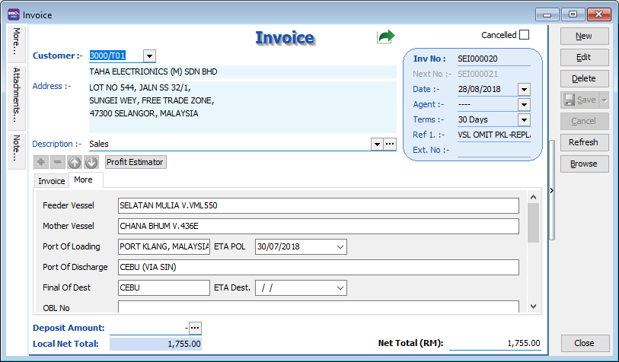
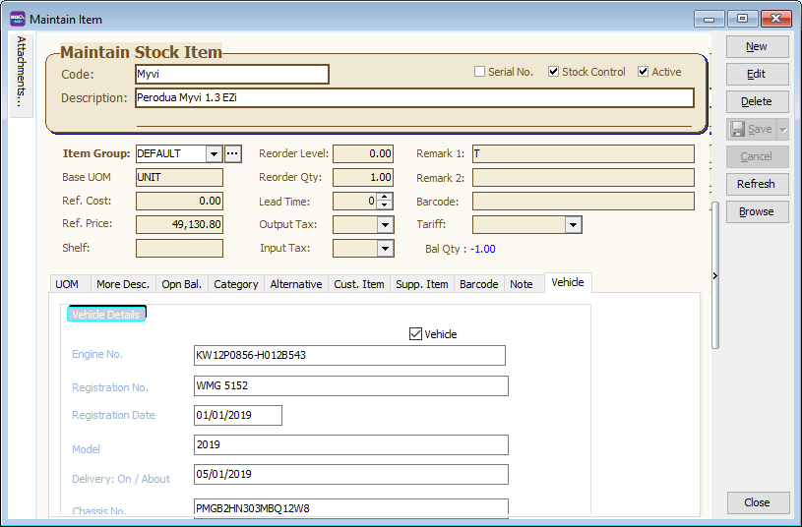
DIY Field
Enhance business logic with flexible SQL Account DIY Field module to suite your business
Kindergarten Industries
Every different document can create different DIY Field for record tracking
Forwarding Industries
Car Industries

Slide 15
Thank You

